Slide 1
System analysis and design CIS5200
Thakkar Hiraj
Allen Daniel
Jorge Martinez

Slide 2
Agenda
Agenda
Data Specification
Introduction
​H/W ​Summary​
Flow Chart

Slide 3
Data specification
Name and Link: InsiderTrading Dataset
Total Size: 32.47 GB
Total Size of Files Used:9.81 GB
Number of Files Used: 3
File Format: CSV

Slide 4
Introduction
This dataset captures insider trading activity at publicly traded companies. The Securities and Exchange Commission has made these insider trading reports available on its web site in a structured format since mid-2003. However, most academic papers use proprietary commercial databases instead of regulatory filings directly, which makes replication challenging because the data manipulation and aggregation steps in commercial databases are opaque and historical records could be altered by the data provider over time. To overcome these limitations, the presented dataset is created from the original regulatory filings; it is updated daily and includes all information reported by insiders without alteration.

Slide 5
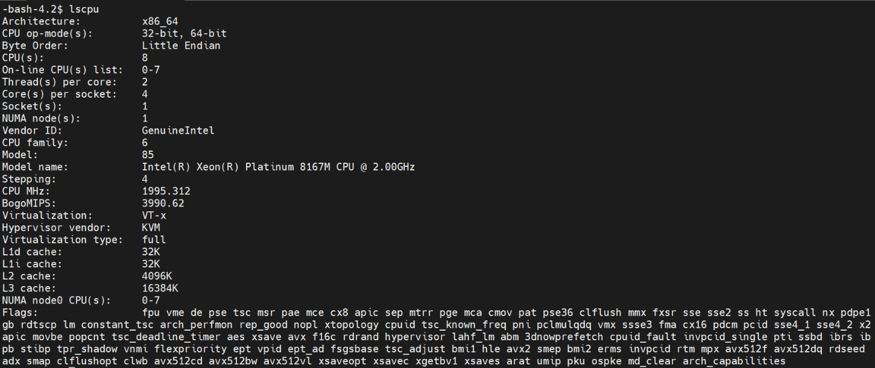
Hw Experimental specifications
Cluster Version | Hadoop 3.1.2
Cluster Number of Nodes | 3 Nodes
Memory Size | 251.2 GB
CPU Speed | 1995.312 MHz
Number of Core CPU | 3

Slide 6
FLOWCHART OF DATA ANALYSIS
Download Dataset from Kaggle
Upload Dataset to HDFS
Created Table in Beeline
Analysis of Data using Visualization, Bar and Line chart in Excel
Data
Cleaning
Export Results

Slide 7
Workflow Chart
Customers requirements
Planning data/tables
Clean data prior to upload
Confirm data looks correct
Downloaded Dataset to System
Data structuring
Creating Tables
Writing Queries
Saving Files to Local System
Performing Visualization
Analysis

Slide 8
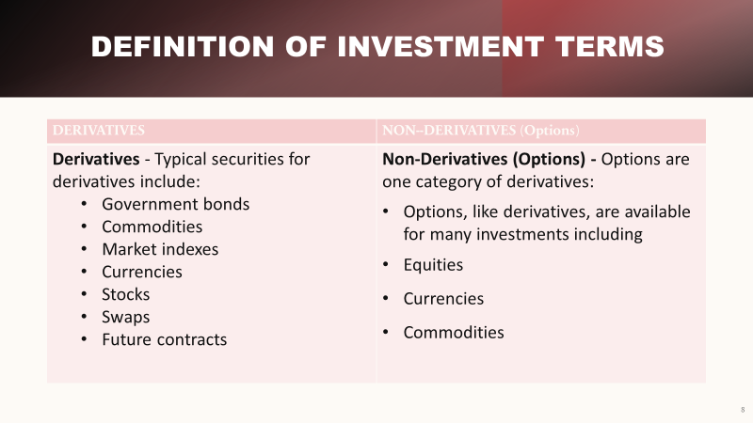

Slide 9
Derivative Visualization Techniques
-Derivative visualization techniques involve the analysis of financial instruments such as options and futures contracts to identify potential instances of insider trading. For example, if someone purchases a large number of call options on a stock just before a positive earnings announcement, it could indicate that they had access to insider information.
-Another example of derivative visualization is network analysis. This technique involves mapping out relationships between individuals and companies to identify potential insider trading networks. By analyzing patterns of trading and communication, it may be possible to identify key players in an insider trading scheme.

Slide 10
Non-Derivative Visualization Techniques
Non-derivative visualization techniques involve the analysis of publicly available information to identify potential instances of insider trading. This can include analyzing trading patterns, news articles, and social media activity. One example of non-derivative visualization is sentiment analysis. This technique involves using natural language processing to analyze the tone and context of social media posts related to a particular company or stock. If there is a sudden surge in positive sentiment surrounding a company, it could indicate that insiders are buying up shares in anticipation of good news.

Slide 11
How does reporting owner’s insider trading visualization work?
Reporting owners’ insider trading visualization works by aggregating the data from Form 4 filings and presenting it in an easy-to-understand format. The tool typically includes features such as interactive charts and graphs that allow users to filter the data based on various criteria. Users can view the trading activity of individual reporting owners or aggregate the data to see overall trends. The tool may also include alerts that notify users when a reporting owner makes a significant trade or when there is a sudden increase in trading activity.

Slide 12
Data collection
Top 5 securities whose derivatives were most frequently traded
Security whose derivative had the highest average transaction value (Minimum 100 transactions):
Number of transactions by date for Derivatives that were traded
Number of insider trades reported by area

Slide 13
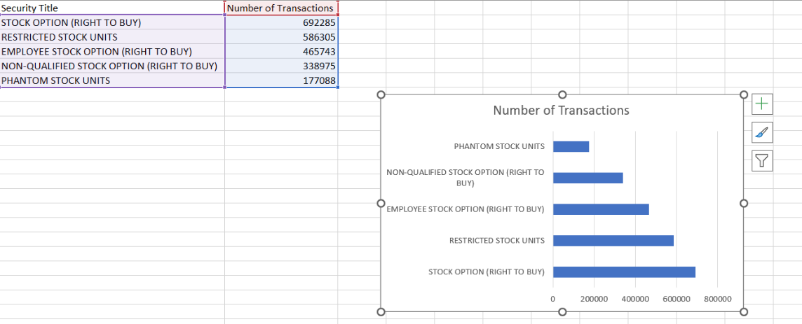
Query 1
Top 5 securities whose derivatives were most frequently traded
INSERT OVERWRITE DIRECTORY '/user/hthakka4/tmp/'
ROW FORMAT DELIMITED FIELDS TERMINATED BY ','
SELECT
transactionDate,
transactionType,
COUNT(*)
FROM
cleaned_derivatives
GROUP BY
transactionDate,
transactionType
We decided to use the top 5 securities to understand the trends that are going on but to also help to calculate the value of various assets and also find out the effect of various market fluctuations on the value of tradable financial instruments

Slide 14
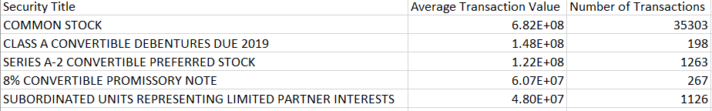
Query 2
Security whose derivative had the highest average transaction value (Minimum 100 transactions):
INSERT OVERWRITE DIRECTORY '/user/hthakka4/tmp/'
ROW FORMAT DELIMITED FIELDS TERMINATED BY ','
SELECT
securityTitle AS securityTitle,
AVG(transactionTotalValue) AS average_transaction_value,
COUNT(securityTitle) AS number_of_transactions
FROM
cleaned_derivatives
GROUP BY
securityTitle
HAVING
number_of_transactions > 100
ORDER BY
average_transaction_value DESC
LIMIT 5
;
We decided to use the highest average to understand the patterns on transactions this will help see which transactions have bee volatile or safe/risky.

Slide 15
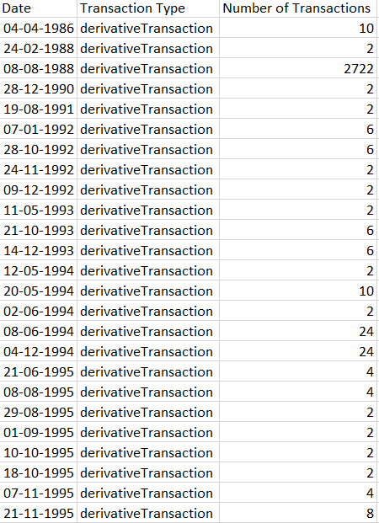
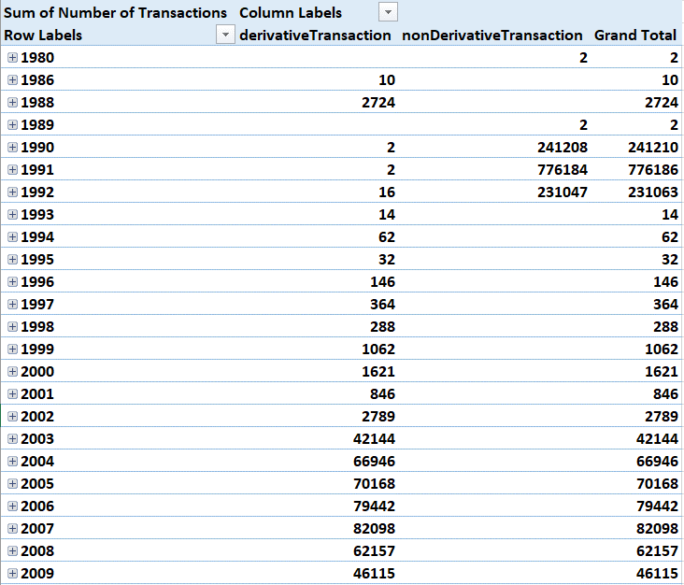
Queries 3&4
Non-Derivative transactions with highest price per share
&
Number of insider trades reported by area
Using the highest price per share we can see trends threw out the years if the share is at a low it would be good to grab or if it’s too high it might be a risk this helps us asses the situation to either hold or sell.
By analyzing the number of insides trades by area helps us stay away from that area reducing the risks
This also it is unfair and discourages ordinary people from participating in markets, making it more difficult for companies to raise capital

Slide 16
Visuals of Geo Maps
One way to visualize the insider trading data set is through the use of geo-maps. By plotting the location of trades on a map, researchers can identify geographic patterns in insider trading activity. For example, they may be able to identify regions or countries where insider trading is more prevalent. This information can be useful for regulators and law enforcement agencies seeking to crack down on insider trading.

Slide 17
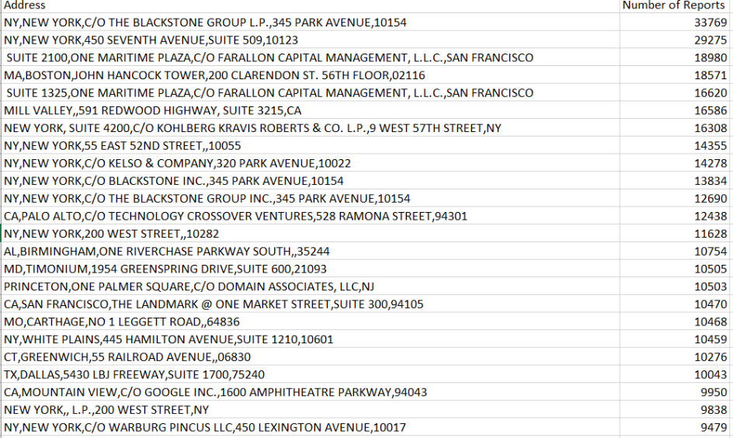
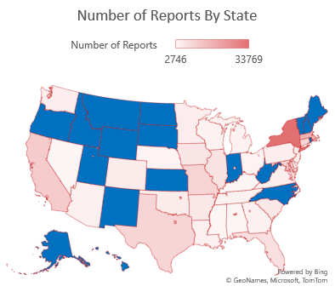
QUERY 5
WHAT ARE The number of insider trades reported by area?
GEO – SPATIAL VISUALIZATION

Slide 18
SUMMARY
By understanding the different queries, we are able to make sound and conscience decisions for our clients when it comes to trading. But it also helps us understand future trends.
Overall, the insider trading data set provides valuable insights into the patterns and trends associated with this illegal practice. Using geo maps and other visualizations, researchers identify geographic patterns in insider trading activity and take action to prevent illegal trades. While there are challenges associated with the analysis of these data sets, the benefits of using them far outweigh the drawbacks.

Slide 19
THANK YOU
Mirjam Nilsson​
mirjam@contoso.com
www.contoso.com
Github Link: https://github.com/Hiraj151?tab=repositories

